Slide 1
Public Cloud 202: Azure Networking with vWAN Internet Inbound
John McDonough / Srija Reddy Allam Cloud Security Architects

Slide 2
Azure Virtual WAN
What is vWAN
Components of a vWAN

Slide 3
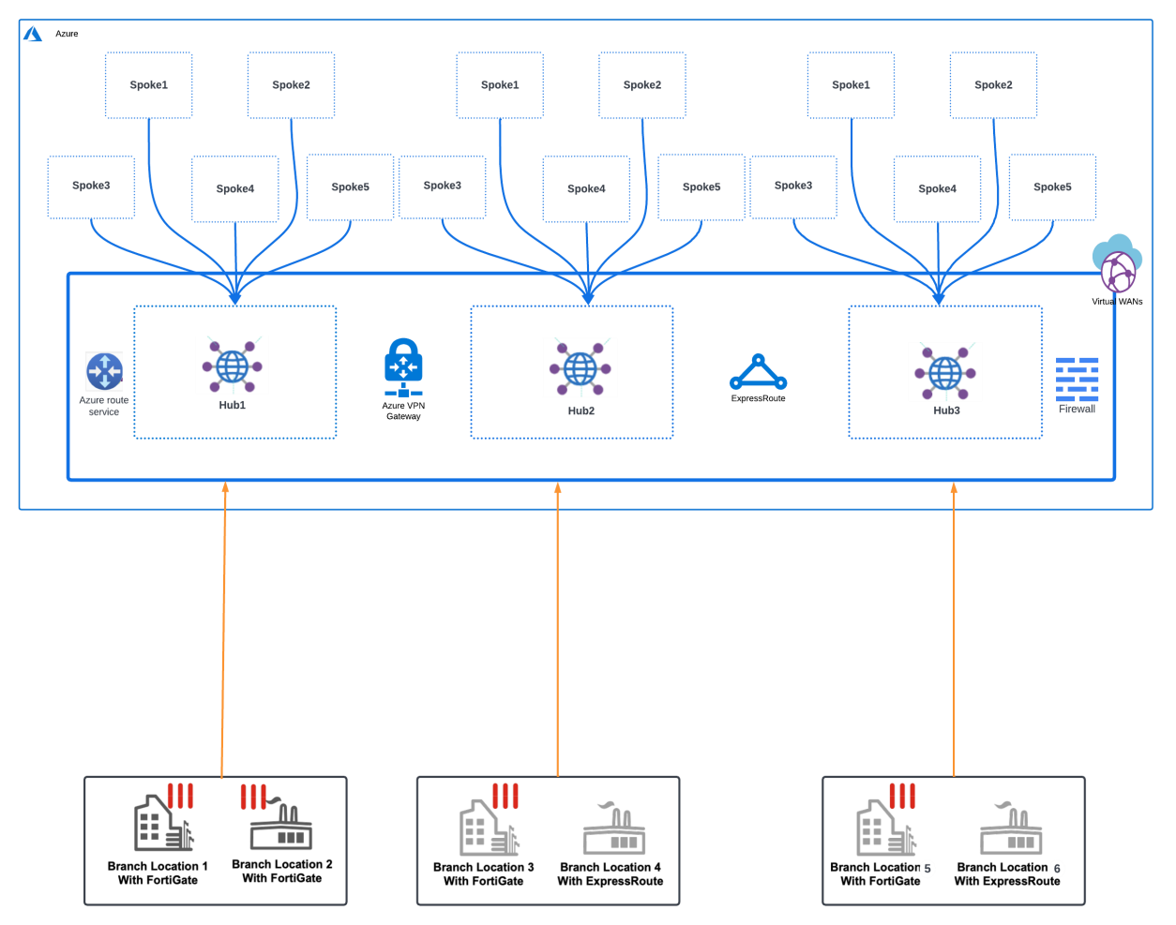
What is Azure Virtual WAN
Simplifies management of various hub and spoke deployments providing centralized security
Automated large-scale branch connectivity using VPN and Express Route services
Unified network and policy management
Optimized routing using the Microsoft global network
Provides advanced routing enhancements – BGP and Routing Intent
Ability to integrate with Fortinet FortiGate solutions providing SD-WAN and NGFW services

Slide 4
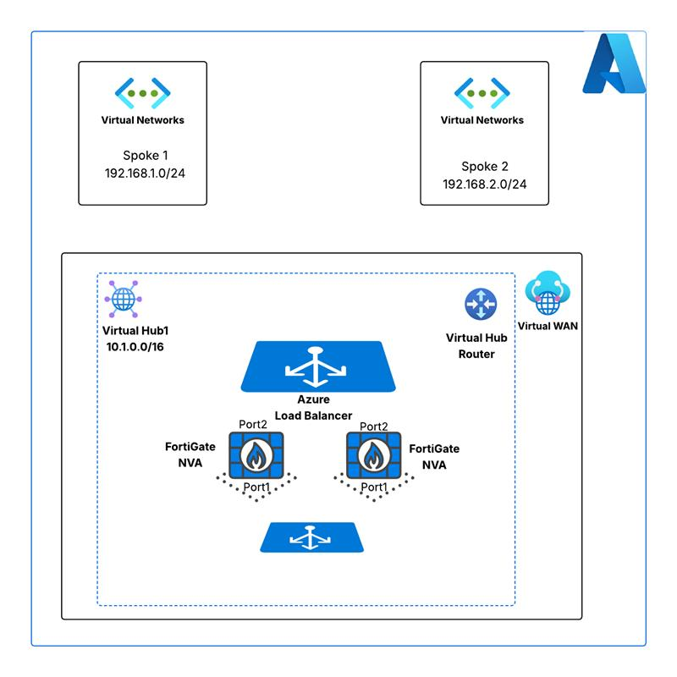
Virtual WAN Components – Virtual WAN
Managed Service deployed from Azure portal
Simple deployment template
Name
Region
Resource Group
Type (connectivity options)
Standard
Basic
**Already deployed for this lab because of time.

Slide 5
Virtual WAN Components – Virtual Hub
Managed Service deployed from Azure portal
Simple deployment template
Name
Region
Resource Group
Address space
Capacity (Scale Units)
Routing Preference
AS Path
Express Route
VPN
Additional Services
**Already deployed for this lab because of time.

Slide 6
Virtual WAN Components – Virtual Networks
VNETS deployed from Azure portal
Comprehensive deployment template
Name
Region
Resource Group
Address space
Subnets
Additional Services
Virtual Machines
**Already deployed for this lab because of time.

Slide 7
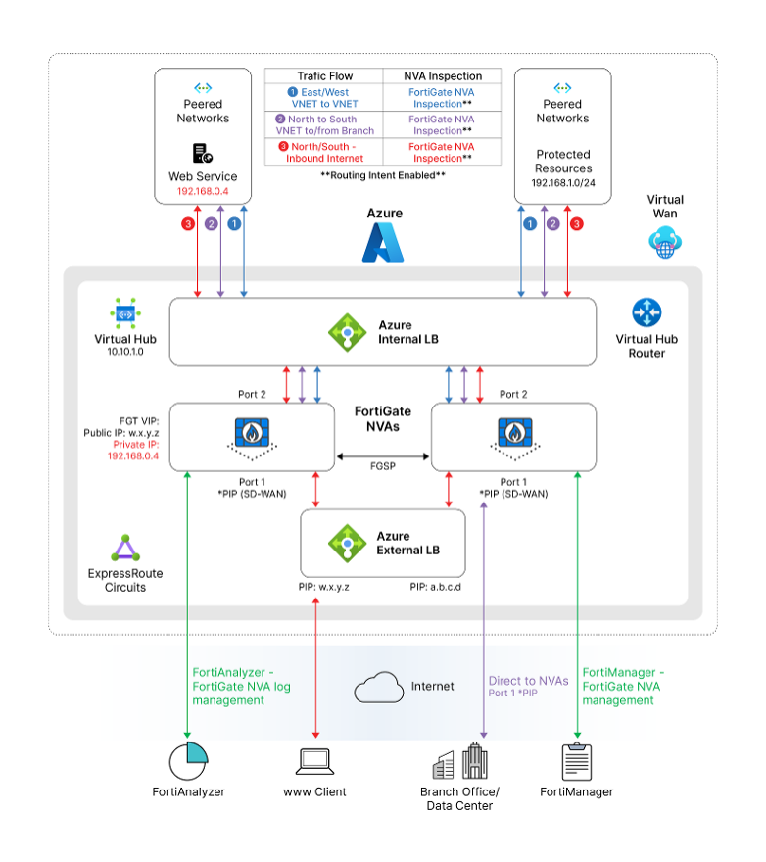
Virtual WAN Components – FortiGate NVA
FortiGate NVAs deployed from Azure portal - VWAN Hub page
Simple deployment template
Name
Region
Resource Group
Address space
Subnets
Additional Services
Ingress Public IP
Ingress External Load Balancer
Virtual Machines
**Attendee will deploy

Slide 8
Getting Started
Moderated by instructors
Username assignments
https://fortinetcloudcse.github.io/azure-202-advanced
Review lab material

Slide 9
FortiGate Integration with Azure VWAN
The industry’s first fully Integrated network virtual appliance providing Secure SDWAN AND Next Generation Firewall Services
Simple and structured deployment model
Deployed via Azure portal – Managed service
SDWAN and/or NGFW deployment options
High Availability and Resiliency
Active-Active – up to 5 FortiGates (NGFW)
Performance and Scale
Dynamic Routing Capabilities
Single management interface – FortiManager – Appliance / VM
Centralized logging – FortiAnalyzer – Appliance / VM
Flexible licensing options
BYOL / FortiFlex
PAYG – New in Q2 2024

Slide 10
Azure Marketplace Plan
NGFW
SD-WAN & NGFW

Slide 11
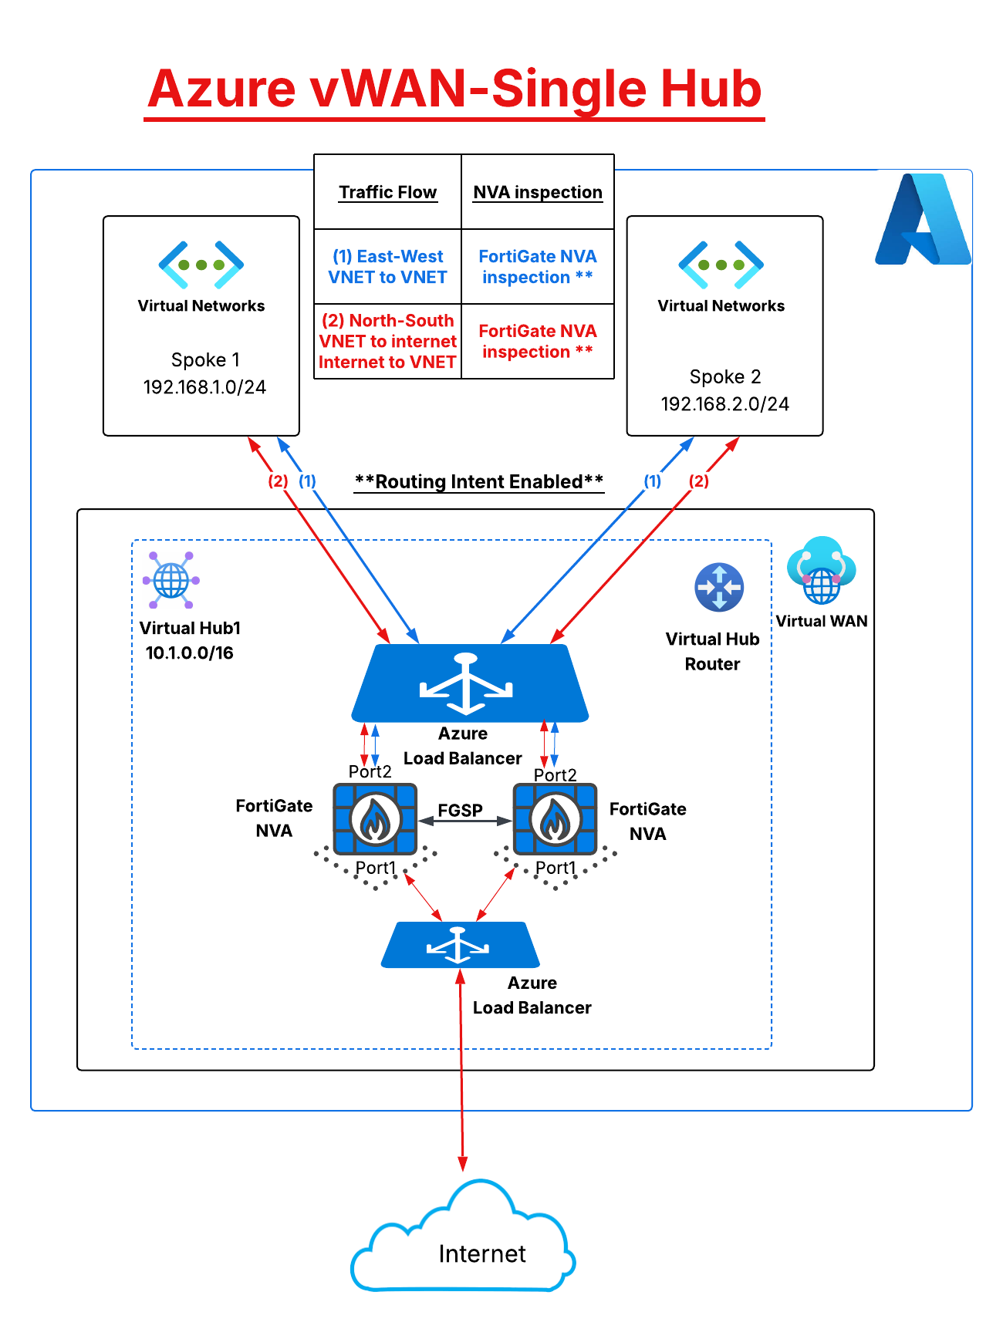
NGFW Only - Option
Inspects East-West and Internet bound traffic
Network inspection across VNETs connected to the
Virtual WAN
Internet bound traffic inspection
High Availability and resiliency
Active-Active - supports up to 5 VMs and 80 Gbps
Performance and Scale
Dynamic Routing Capabilities
Single management interface – FortiManager – Appliance / VM
Centralized logging – FortiAnalyzer – Appliance / VM
Flexible licensing options
BYOL / FortiFlex
PAYG

Slide 12
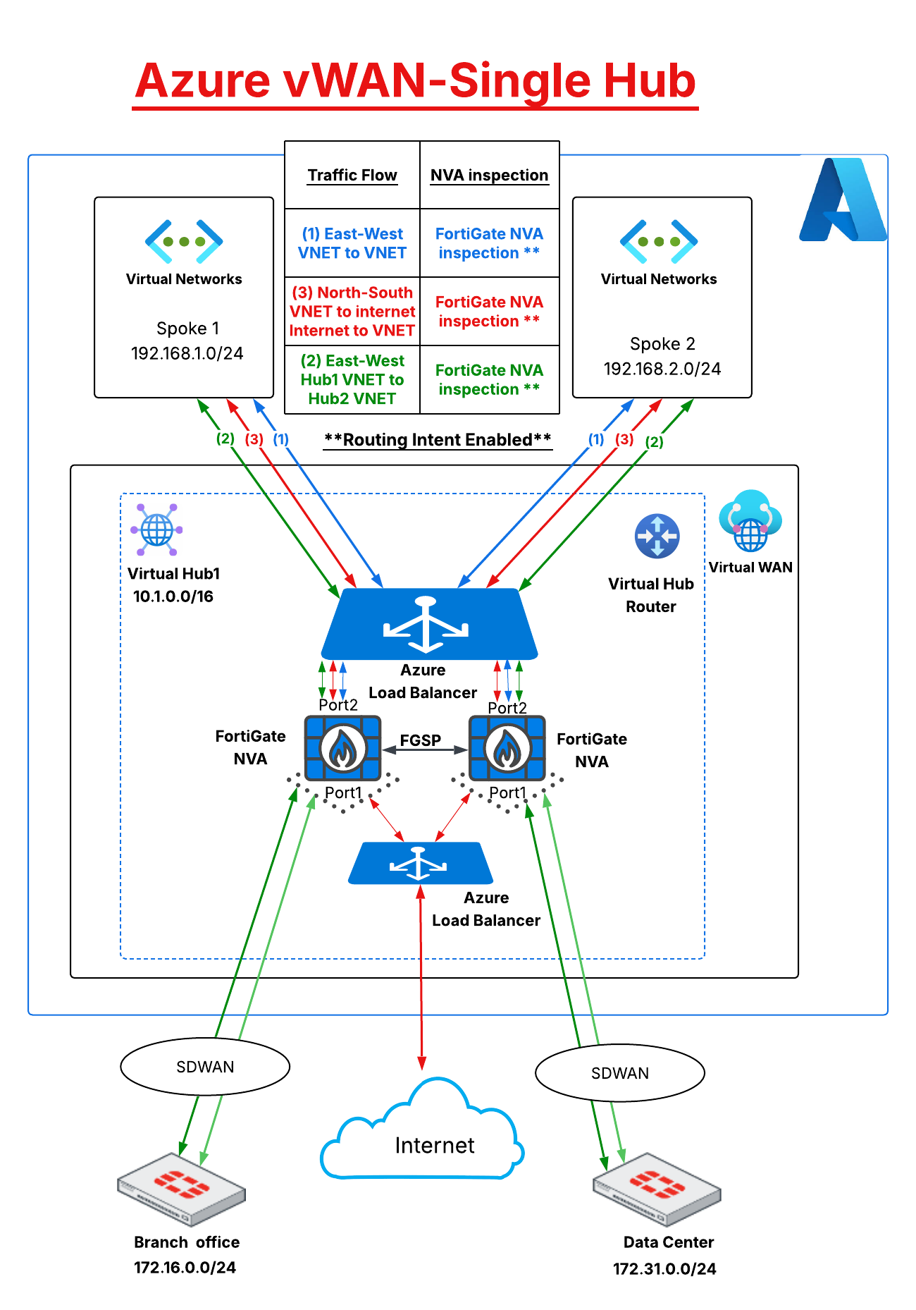
SDWAN & NGFW - Option
North-South inspection for traffic destined to the Internet or the SDWAN connected networks. (See red & green traffic flows on the diagram)
Inspection across vNETs connected to the virtual WAN (See blue traffic flow on the diagram)
High Availability and resiliency
Active-Active – supports 2 VMs up to 10Gbps
Performance and Scale
Dynamic Routing Capabilities
Single management interface – FortiManager – Appliance / VM
Centralized logging – FortiAnalyzer – Appliance / VM
Flexible licensing options
BYOL / FortiFlex
PAYG

Slide 13
Order Types in VWAN

Slide 14
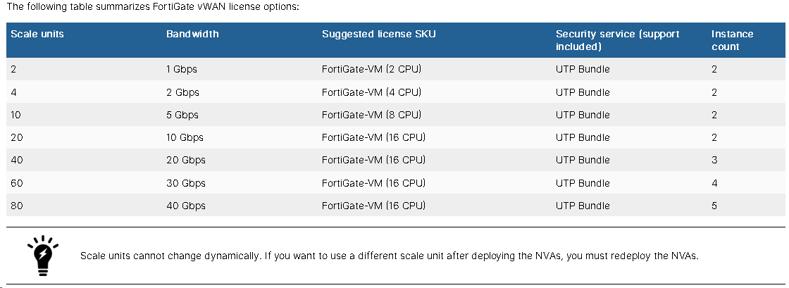
NGFW Only – Scale Units

Slide 15
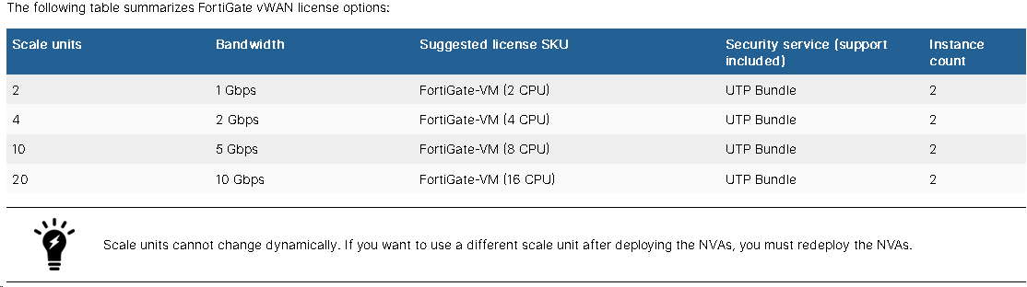
SDWAN & NGFW – Scale Units

Slide 16
Questions

Slide 17
Lab Overview

Slide 18

5x columns
Paragraph Text
Overview
Deploy
Configure
Route
Verify
Connect to Azure Environment
Review Resources
Deploy FortiGate NVAs in Azure VWAN Hub
Deploy 2nd vWAN
Deploy Linux VMs
Configure FortiGates
Configure FGSP
Firewall Policies
Configure VNET peering
Configure FortiGate Static Routes
Ensure BGP peering
Configure Azure Routing Intent
Configure Internet Ingress
Verify Spoke to Spoke
Verify Spoke to Internet
Verify Internet to Spoke
Verify Hub to Hub

